Slide 1


Megaproject XCELS
XCELS - world most powerful laser infrastructure that will be built at
the Institute of Applied Physics in Nizhny Novgorod
to study the properties of matter and vacuum in the presence of extreme light
XCELS+
XCELS
ELI-DC
Ascent to the highest intensity of light,
"the Extreme Light"
www.xcels.iapras.ru
XCELS - Exawatt Center for Extreme Light Studies

Slide 2
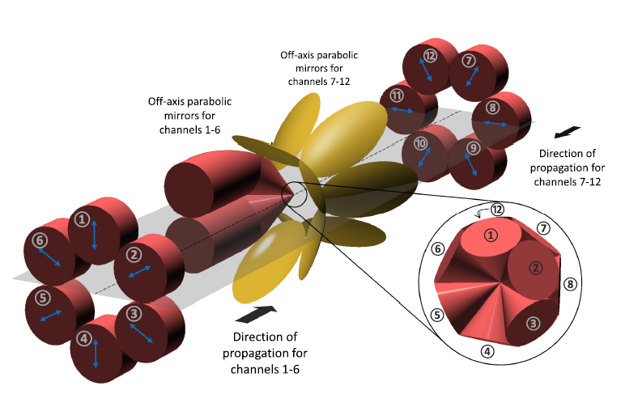
Megaproject XCELS
Laser source for XCELS
  XCELS is based on the 200 Petawatt (2 × 10¹⁷ Watt) laser facility that exceeds the current record power level by 100 times. It comprises 12 amplification channels, each producing a laser pulse with 400 J energy and 25 femtosecond pulse duration.
A specially designed focusing system provides the ascent to the highest intensity level of 10²⁵ - 10²⁶ W/cm² by combining 12 laser beams. The resulting energy density in the focal area attains 10¹⁶ J/cm³, several orders of magnitude higher than in the center of the Sun.
XCELS - Exawatt Center for Extreme Light Studies

Slide 3
Laser or Parametric Amplification?
Pump
Pump wave
Laser
pulse
Signal
Laser medium
Nonlinear crystal
Laser amplification
Parametric amplification

Slide 4
Megaproject XCELS
XCELS – OPCPA scheme
Nanosecond pump pulse
Chirped femtosecond signal
XCELS - Exawatt Center for Extreme Light Studies
Notes:
4

Slide 5

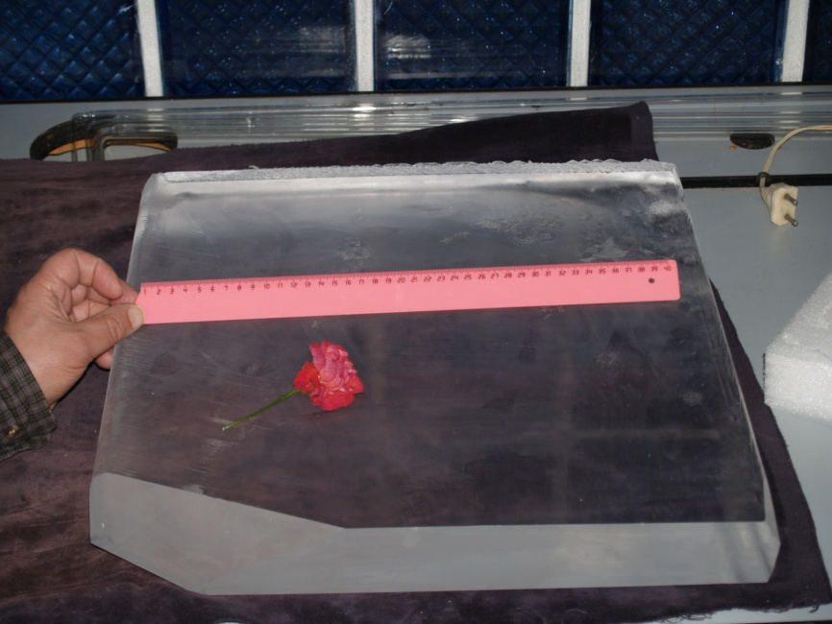
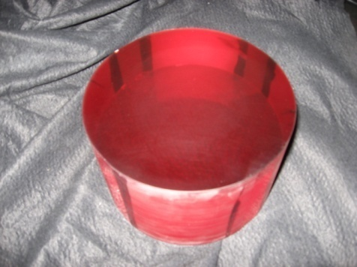
Laser or Parametric Amplification?
Crystal Systems, USA
RSA Le Rubis, France
IAP RAS
Cleveland Crystals, USA
Ti:Sa boule, diameter 192 mm,
height 122 mm.
Crystal KDP, 40х40 см²

Slide 6
Строящиеся мультипетаваттные лазеры:
LULI Apollon 10PW
ELI (ELI-Beamlines, ELI-NP, ELI-ALPS)
SIOM
GIST
ИПФ РАН PEARL10

Slide 7
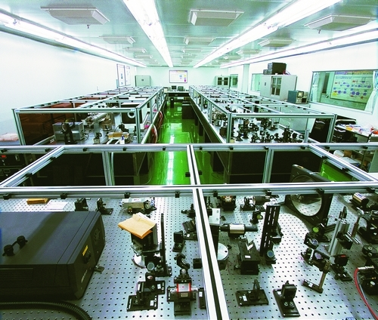

Megaproject XCELS
Progress in China
Ruxin Li, Director of SIOM
Shanghai Institute of Optics and Fine Mechanics (SIOM)
Qiangguang 10 PW laser under construction.
In 2015, the world highest peak power 5 PW (150 J in 30 fs) performance was demonstrated
XCELS - Exawatt Center for Extreme Light Studies
Notes:
7

Slide 8
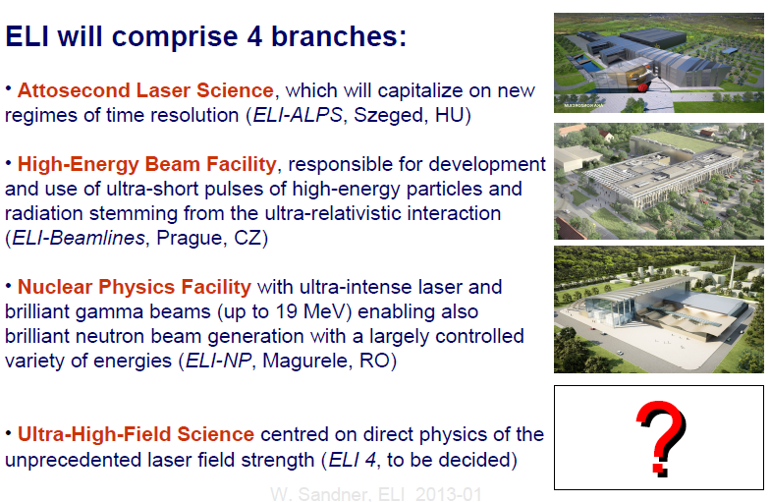
Megaproject XCELS
ELI
XCELS - Exawatt Center for Extreme Light Studies

Slide 9
Megaproject XCELS
XCELS – layout
Key technologies for XCELS facility:
OPCPA technique
3 kJ, 1.5 ns Nd: glass pump lasers
30x30 cm² KD*P crystals
50x100 cm², broad band
(25 fs), 0.2 J/cm² damage threshold
gratings with 910 nm central
wavelength
5. Tight focusing optical system
XCELS - Exawatt Center for Extreme Light Studies
Notes:
9

Slide 10
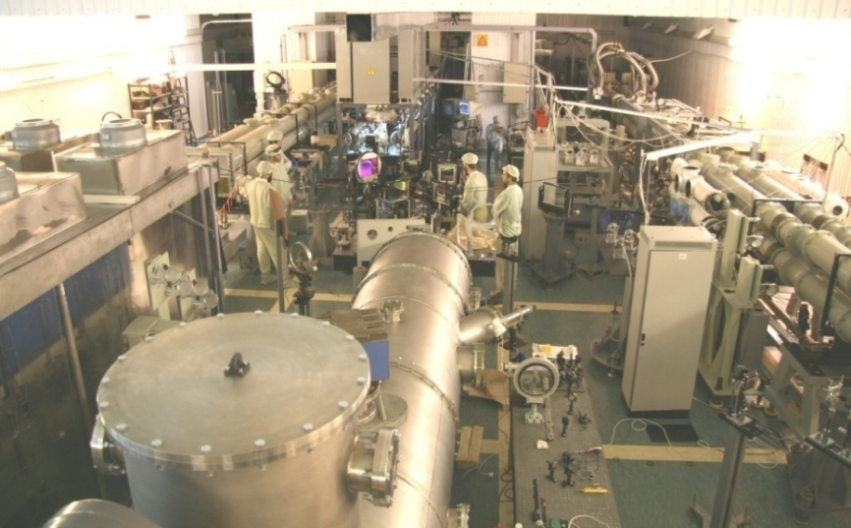
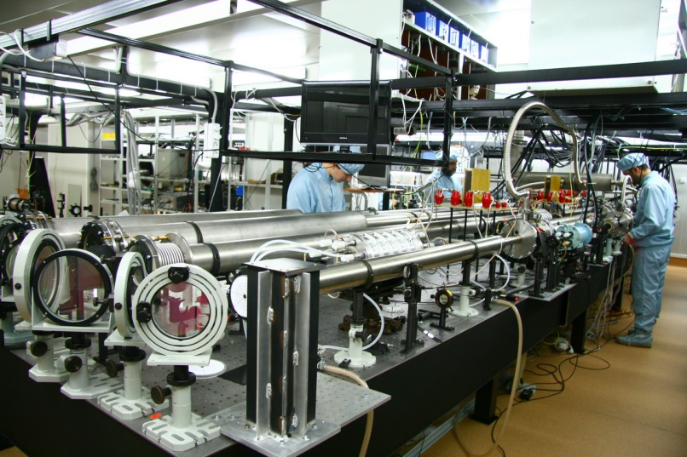
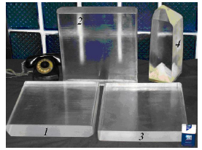
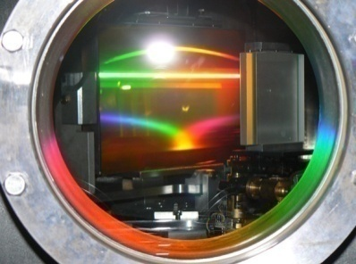
Megaproject XCELS
Key technologies behind XCELS laser facility
The XCELS laser facility is based on the technologies developed at the Institute of Applied Physics in Nizhny Novgorod and the Russian Federal Nuclear Center in Sarov and implemented in PEARL and FEMTA, the world’s first petawatt parametric lasers
FEMTA
PEARL-10
Large aperture nonlinear crystals and optical gratings provide amplification and compression of laser pulses to multipetawatt level
XCELS - Exawatt Center for Extreme Light Studies

Slide 11
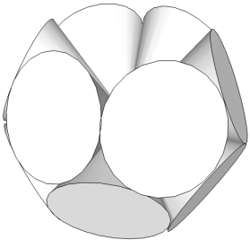
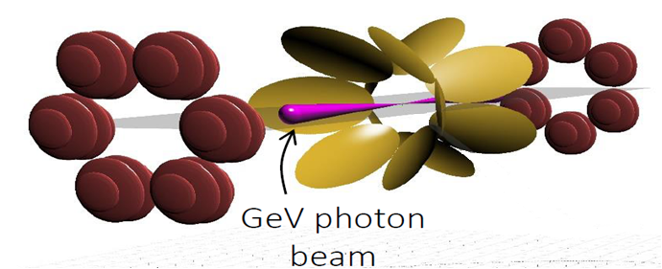
Megaproject XCELS
XCELS – Coherent combining to mimic converging dipole wave
Geometry | Power per channel | Intensity, ×10²⁵W/cm² | I/I(f=1.2) | Equivalent power (f=1.2)
Single beam (f=1.2) | P₀=10 PW | 0.06 | 1 | 10 PW
Single beam (f=1.2) | P₀=200 PW | 1.2 | 1 | 200 PW
Dipole-Wave | P₀=200 PW | 16.7 | 13.9 | 2800 PW
Double-Belt-12 12× (f=0.96) | P₀/12 | 13.4 | 11.2 | 2200 PW
XCELS - Exawatt Center for Extreme Light Studies
Notes:
11

Slide 12
Megaproject XCELS
New science with XCELS
With XCELS we will enter a new realm of physics
Exawatt-scale laser will bring particle dynamics in the radiation dominated regime
QED cascades and radiation trapping of particles produce ultrarelativistic, ultradense e-e+ plasma that efficiently convert optical energy to gamma rays
Controllable directed gamma ray sources of GeV photons with extreme brilliance will be soon available as a new instrument to study nuclear matter and vacuum physics
Laboratory astrophysics will be provided with Gigagauss and Teragauss magnetc fields on the Earth
By energy conversion from femtosecond to attosecond pulses, the Schwinger field can be approached and time-space structure of vacuum can be studied
XCELS - Exawatt Center for Extreme Light Studies
Notes:
12

Slide 13
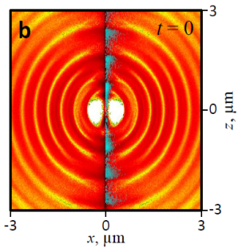
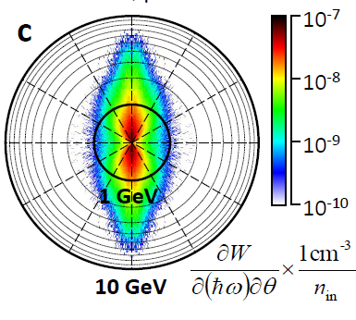
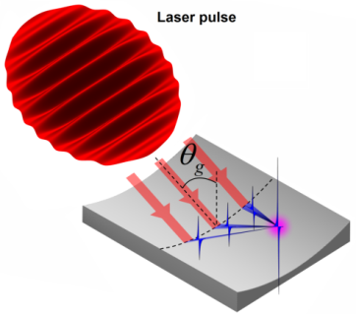
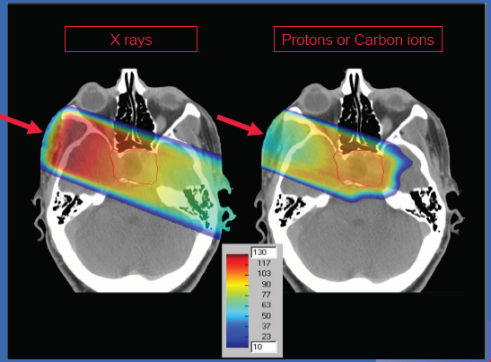
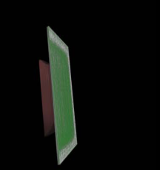
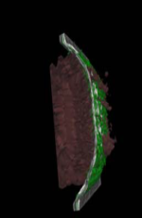
Megaproject XCELS
Prospects for fundamental research and applications
Ultrarelativisitic laser-matter interaction
Exotic states of matter with ultrahigh energy density, laboratory astrophysics
Phenomena of nonlinear quantum electrodynamics in the presence of ultraintense laser fields; ultradense electron-positron plasma
Study of space-time structure of vacuum
Nuclear optics
Ultracompact particle acceleration
Directed brilliant gamma-ray sources
Material diagnostics and metrology with picometer spatial and subfemtosecond temporal resolution
Advanced particle and radiation sources for medicine, pharmacology, radiography, nuclear inspection and processing
Electron acceleration with rate 1 GeV/cm
Directed Γ-ray source with 10 GeV quanta
10²⁸ W/cm²
10 nm
Generation of giant attosecond pulses for probing of quantum vacuum
300 MeV protons from thin foils
for hadron therapy
0.5 mm
XCELS - Exawatt Center for Extreme Light Studies

Slide 14
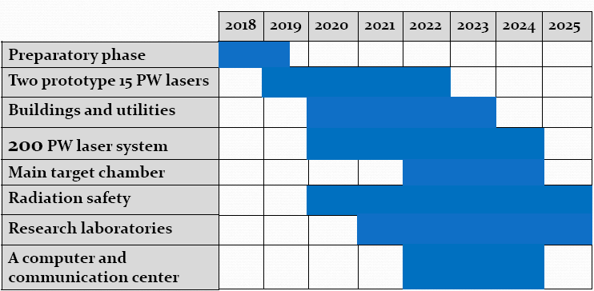
Megaproject XCELS
XCELS - roadmap
Thank you
for attention !
XCELS - Exawatt Center for Extreme Light Studies
Notes:
14

Slide 15
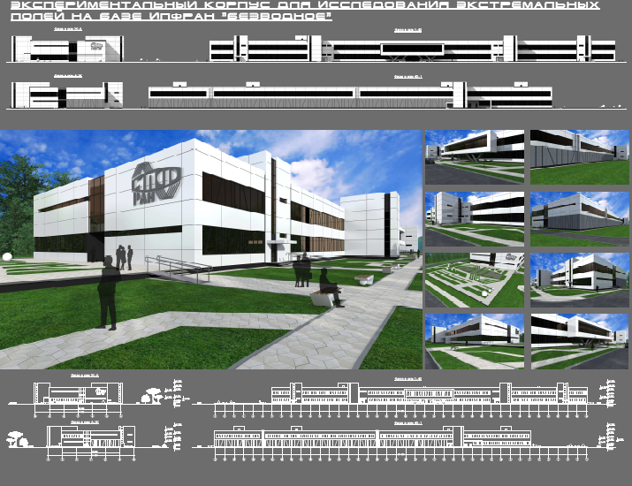
Megaproject XCELS
XCELS – building design
XCELS - Exawatt Center for Extreme Light Studies
Notes:
15

Slide 16
Экстремальные световые поля ?
Рубежи сегодняшнего дня по мощности, интенсивности и длительности лазерных импульсов
W (Дж)
10 Дж
10¹⁵ Вт
I (Вт/см²) =
=
=
= 10²² Вт/см²
τ (с) S (см²)
10⁻¹⁴с 10⁻⁷см²
10⁻⁷ см²
Фемтосекундные длительности импульсов
Петаваттные пиковые мощности

Slide 17
Масштабы интенсивности и напряженности эл.-м. поля
10¹⁵ Вт
e A
Неустойчивость вакуума а=mc²/ħω≈500000
I (Вт/см²)=
=10²²Вт/см²
a =
10⁻⁷ см²
mc²
a ≈ 0.1
I ≈ 3 10¹⁶ Вт/cм²
^{Соответствуют атомному полю,}
^{удерживающему электрон в} ^{атоме} ^{водорода}
Нел. квант. электродинамика а=2e²mc/3ħ²ω≈2000
Радиационное трение а=(3λ/4π r_{e})^{1/3}≈500
Релятивизм электронов а≈1
Внутриатомное поле а=eE_{at}/mcω≈0.1
10¹⁴
10¹⁶
10¹⁸
10²⁰
10²²
10²⁴
10²⁶
10²⁸
10³⁰
Вт/см²
настоящее
будущее

Slide 18
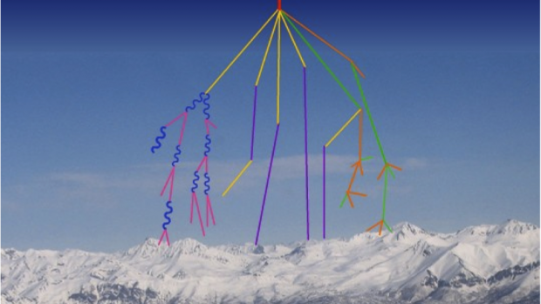
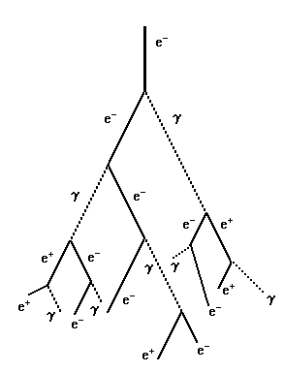
QED cascades
A.R. Bell and J. G. Kirk, Phys. Rev. Lett. (2008)
A.M. Fedotov, N. B. Narozhny, G. Mourou, G. Korn, Phys. Rev. Lett. (2010)
E. N. Nerush, I. Yu. Kostyukov, A. M. Fedotov, N. B. Narozhny, N. V. Elkina, and H. Ruhl,
Phys. Rev. Lett. (2011)
V.F.Bashmakov, E.N.Nerush, I.Yu.Kostyukov, A.M.Fedotov, N.B.Narozhny
Phys. Plasmas (2014)
Message: Vacuum behaves like a rather dense dielectric medium at ionization.
Cascades start at much lower fields (10²⁴-10²⁵ W/cm²) as compared to
Sauter-Schwinger limit (10²⁹ W/cm²)

Slide 19
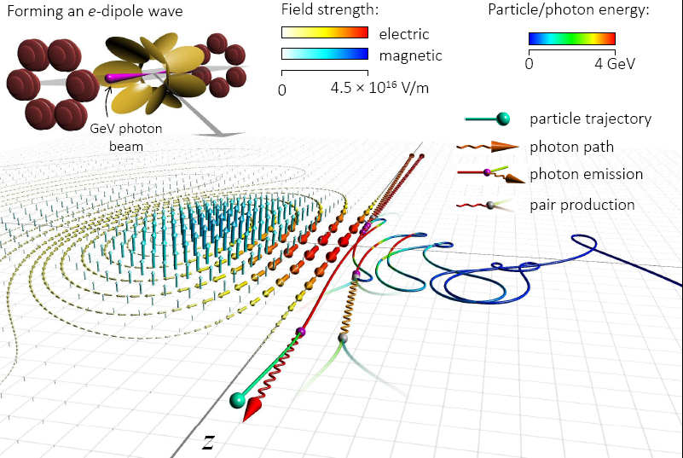
Anomalous radiation trapping and gamma ray emission
A.Gonoskov, A.Bashinov, E.Efimenko et al., PRX, 2017

Slide 20
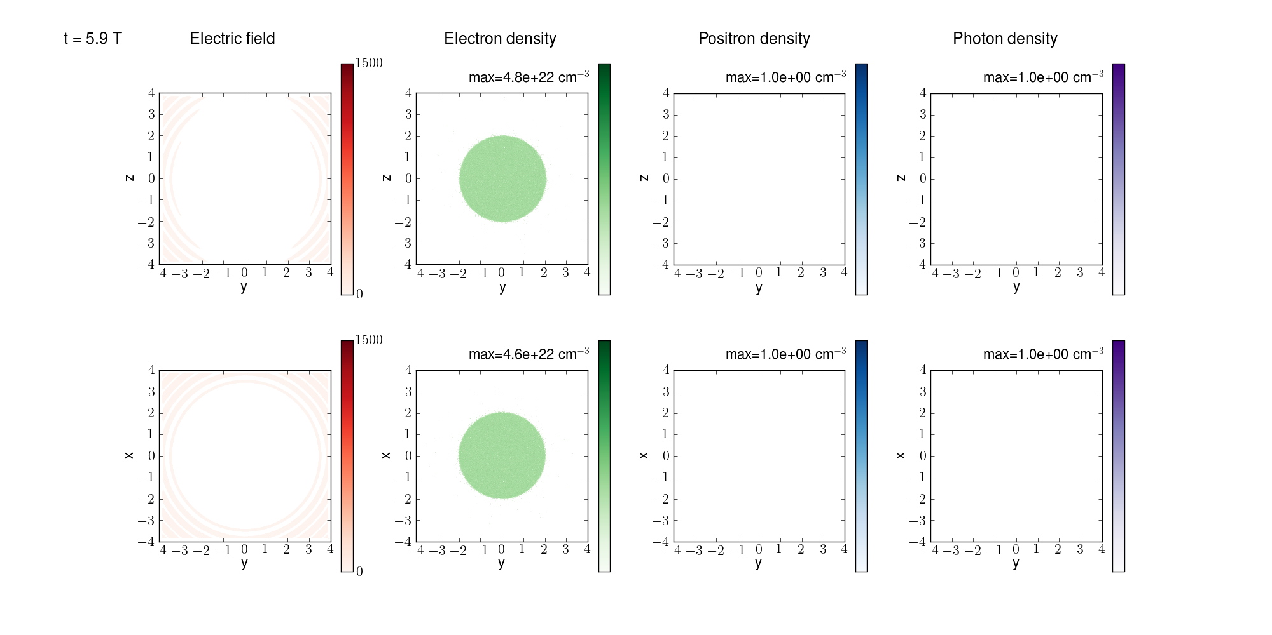
QED cascades in dipole wave
P=100 PW, t=5.9 T

Slide 21
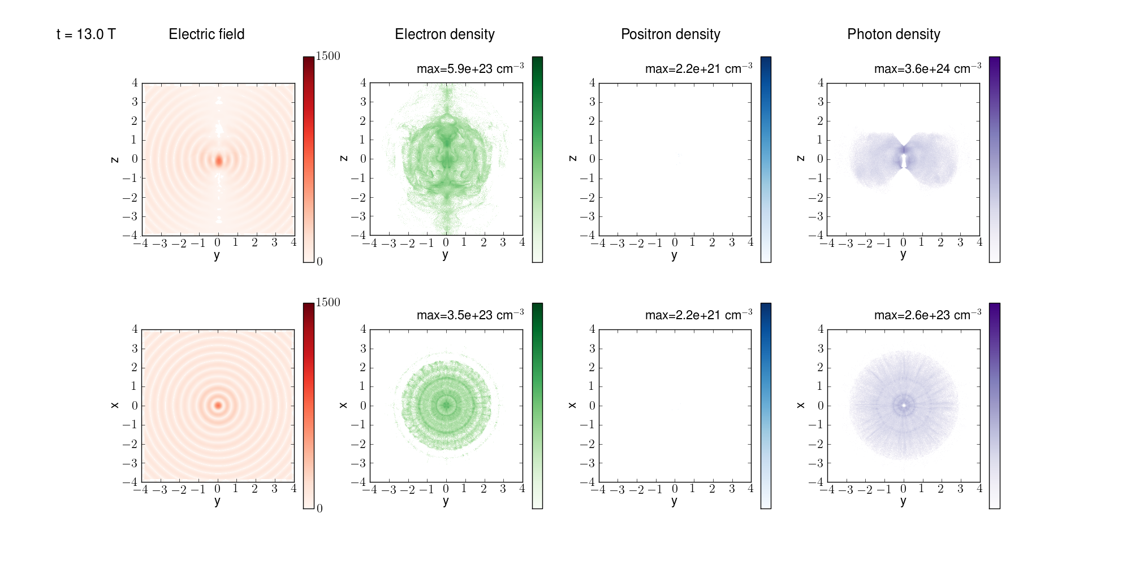
QED cascades in dipole wave
P=100 PW, t=13 T

Slide 22
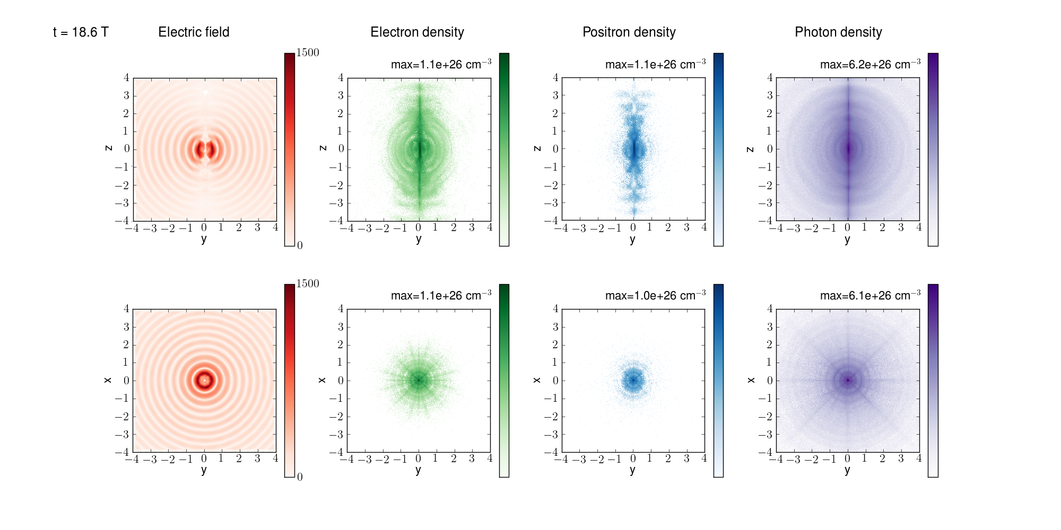
QED cascades in dipole wave
P=100 PW, t=18.6 T

Slide 23
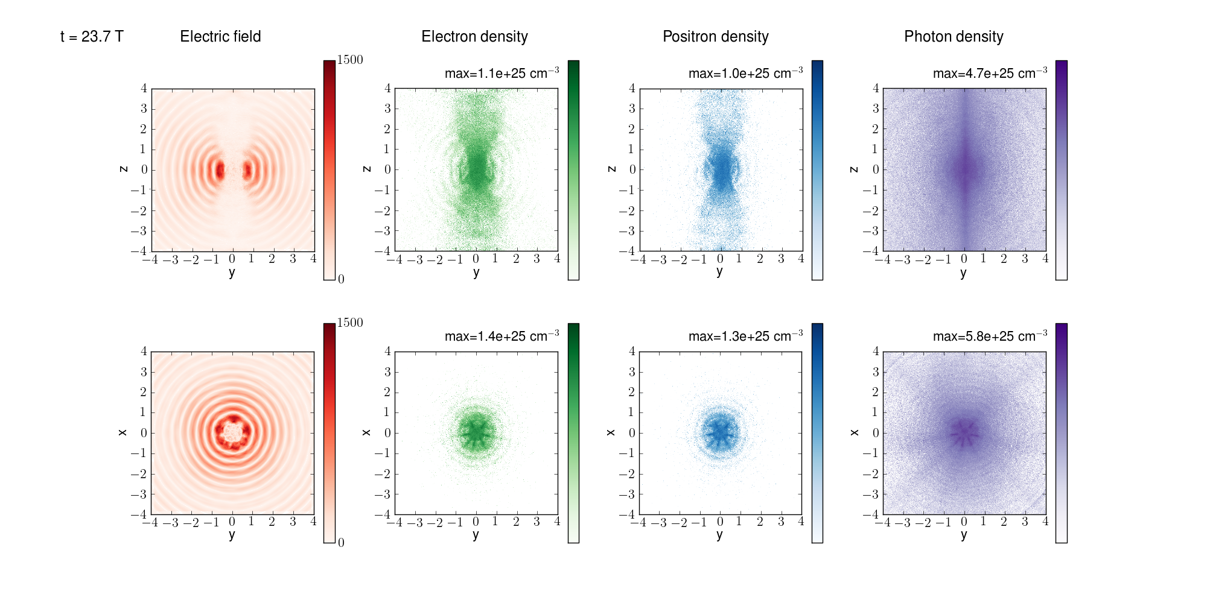
QED cascades in dipole wave
Max electron density > 10 ²⁶ cm⁻³,
Max photon density 6 10 ²⁶ cm⁻³,
10¹³ photon/pulse (E>100 MeV), 10¹⁰ photon/pulse (E>1 GeV)
Limitation by optical pulse refraction from plasma
How nuclei behave in this environment? Can we observe γ-γ collision effects? …………?

Slide 24
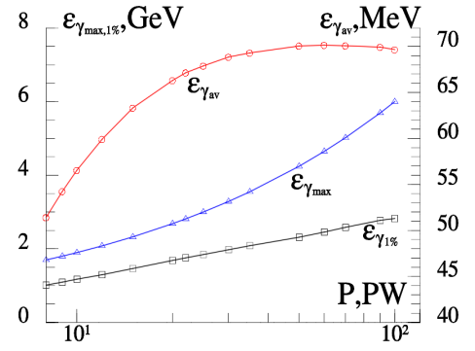
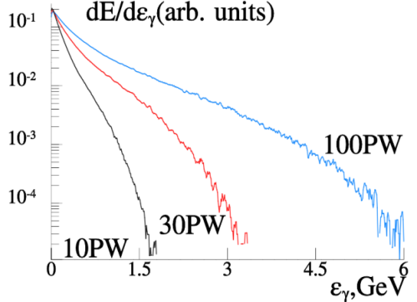
Gamma ray source characteristics
Left. Dependence of average (red line with circles), maximal (blue line with triangles) photon energy and energy at the level 1% (black line with squares) on incoming power P.
Right. Normalized spectra of electron-positron plasma radiation for 10, 30 and 100PW.

Slide 25
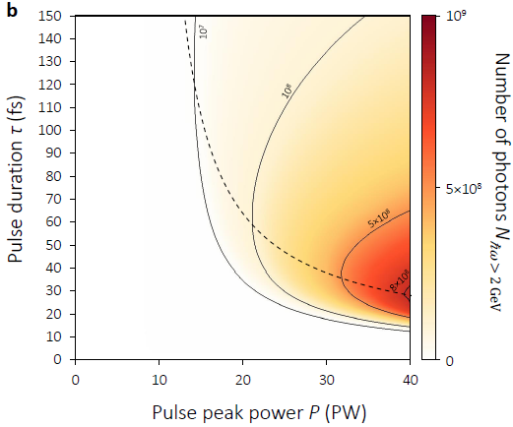
Optimization of GeV photon yield
Nonlinear stage begins at leading edge
Nonlinear stage begins at peak of pulse
There is no nonlinear stage, or nonlinear stage begins at rear front
Maximum photon number slightly vary for power P>40 PW

Slide 26
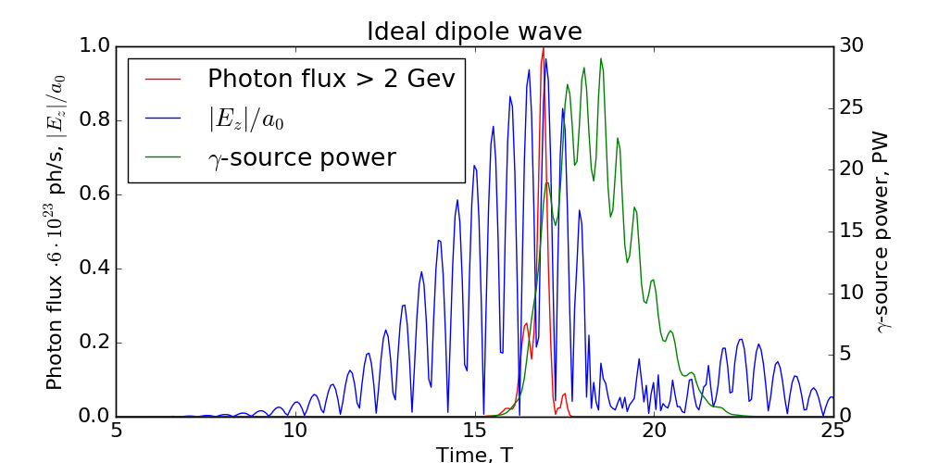
Gamma photon yield for ideal dipole wave
2 GeV photons are emitted only near the maximum of the laser pulse producing sub-period gamma burst
The rear part of the pulse is transformed to gamma quanta with the lower energies almost completely, resulting in overall 34% efficiency

Slide 27
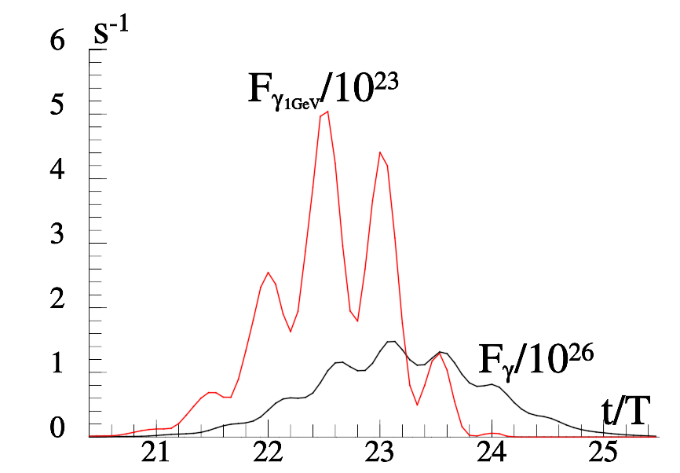
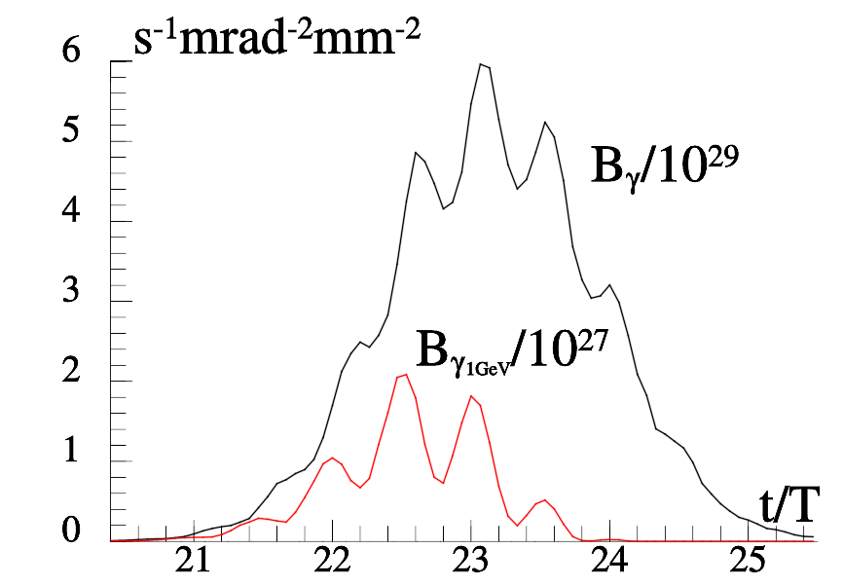
Optimization of GeV photon brilliance
How to make the most brilliant gamma source?
Do not allow degradation of optical wave structure (shorter pulse)
In the case of particular experiments for the Gaussian pulse with the peak power P = 40PW, the duration of τ = 15 fs and the density of the target 10¹⁶cm⁻³. The measured flux and brilliance are shown as a function of time. The duration of the generated gamma pulse is 4.5 fs, maximal brilliance is 610²⁹ s⁻¹mrad⁻²mm⁻² , the number of photons for energies >100MeV is 10¹¹. The photon flux for energies greater 1 GeV is 510²³s⁻¹, number of photons is 10⁹.The beam width for the gamma photons is 2 mrad.
A.Gonoskov, A.Bashinov, E.Efimenko et al., PRX, 2017

Slide 28
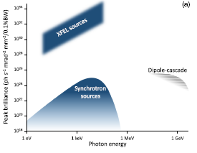
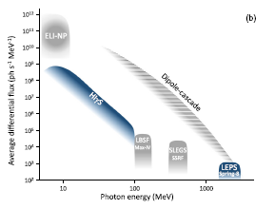
Gamma ray source characteristics
Comparison with existing or planned sources

Slide 29
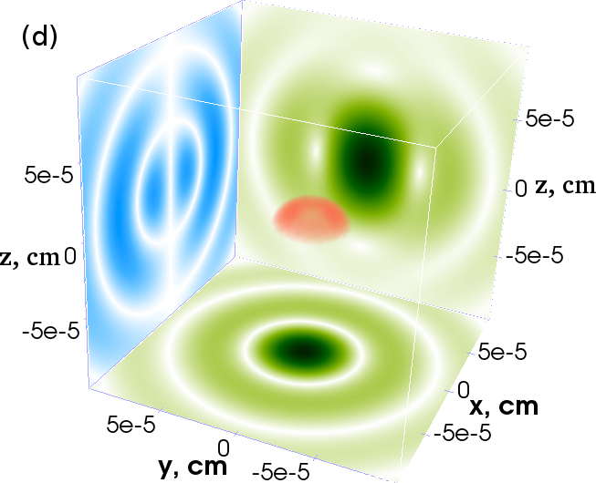
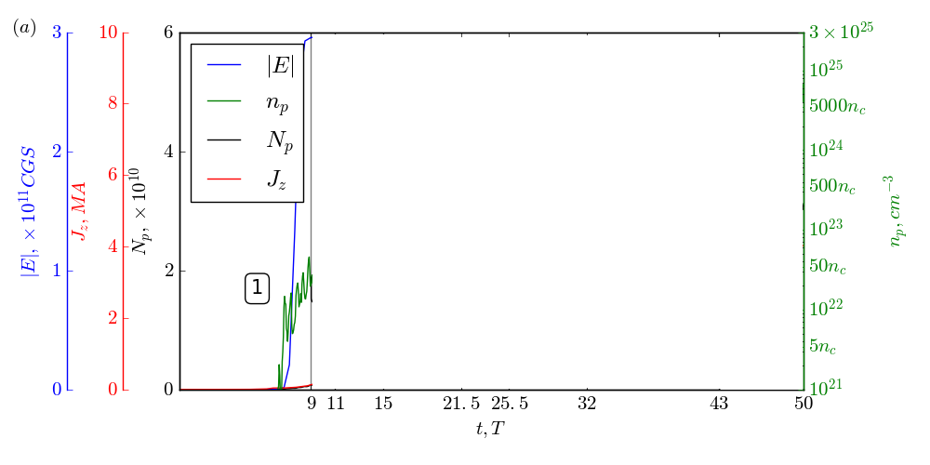
Limitation of cascades and formation of
overdense electron-positron plasma states
1 stage – compression of the target
Target is compressed and standing wave is formed
E.S.Efimenko et al., Scientific Reports, 2018

Slide 30
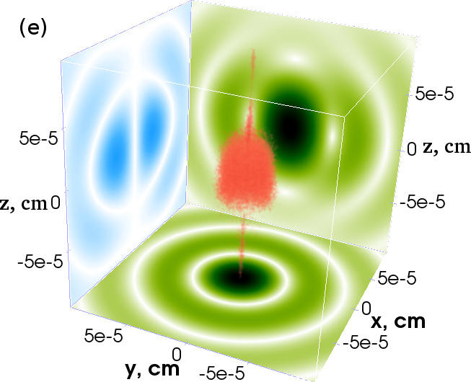
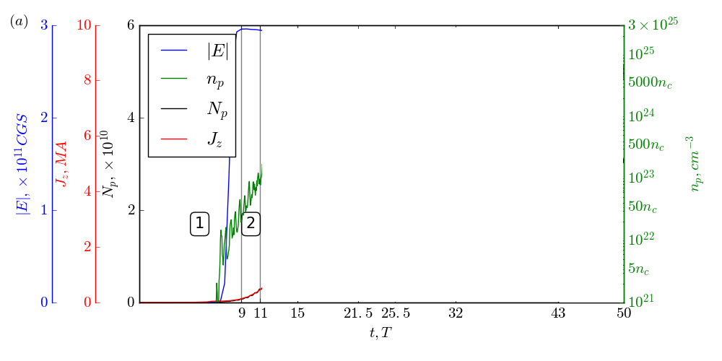
Overdense electron-positron plasma states
2 stage – linear cascade
P > P_{th} (7.2 PW ideal dipole wave)
ART regime

Slide 31
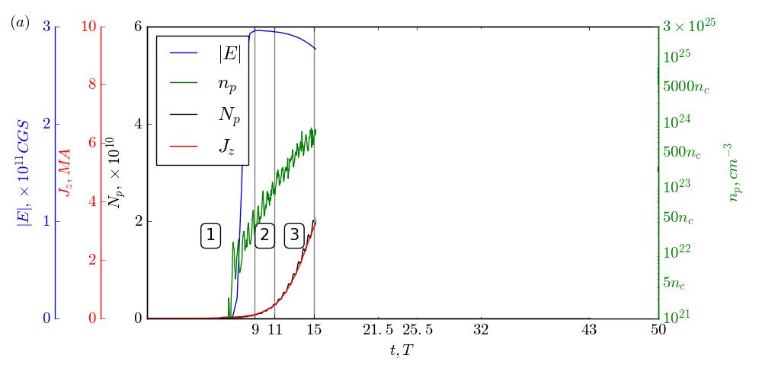
Overdense electron-positron plasma states
3 stage – nonlinear cascade
Density becomes comparable to γn_{c}
Distribution is uniform

Slide 32

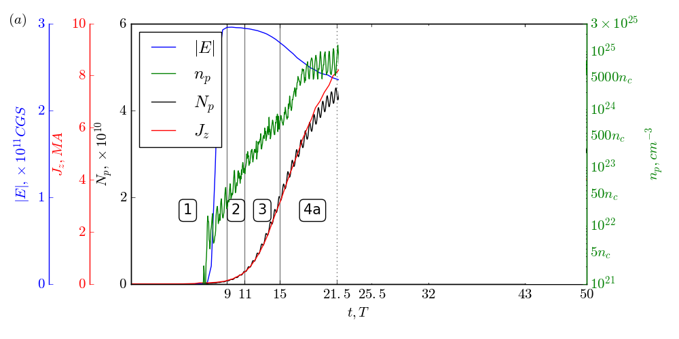
Overdense electron-positron plasma states
4 stage – current (Weibel type) instability
Density becomes nonuniform

Slide 33
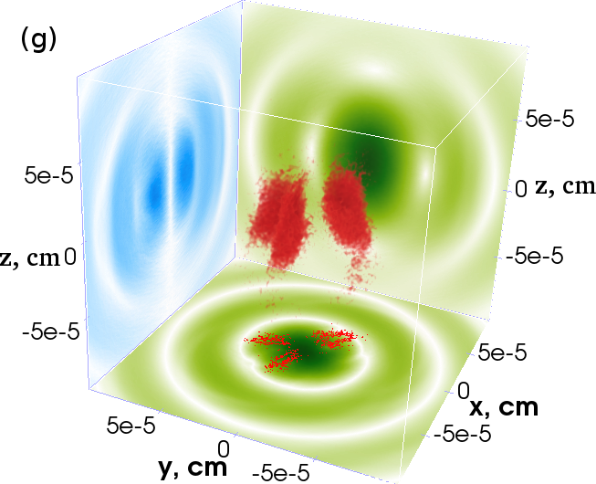
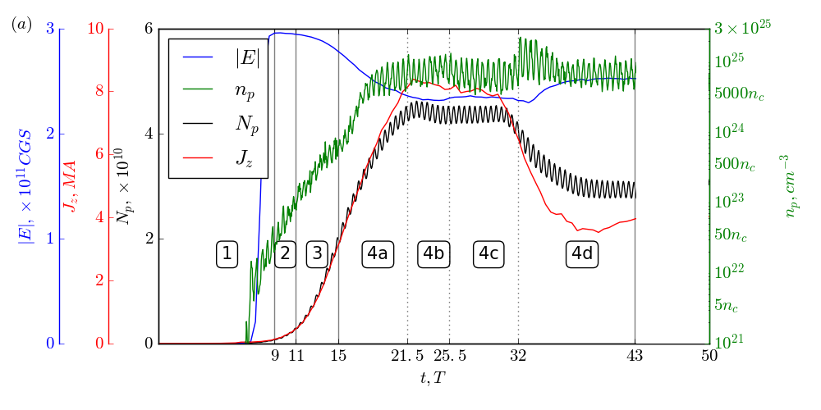
Overdense electron-positron plasma states
4 stage – current merger
Density distribution is a number of sheets
After each merger relaxation

Slide 34
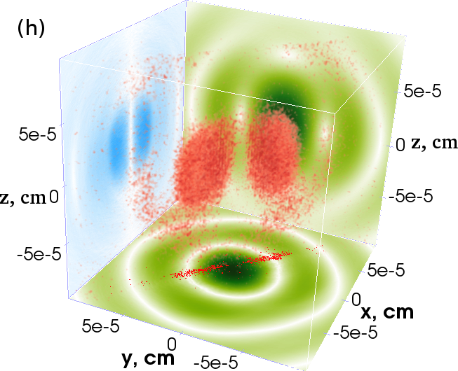
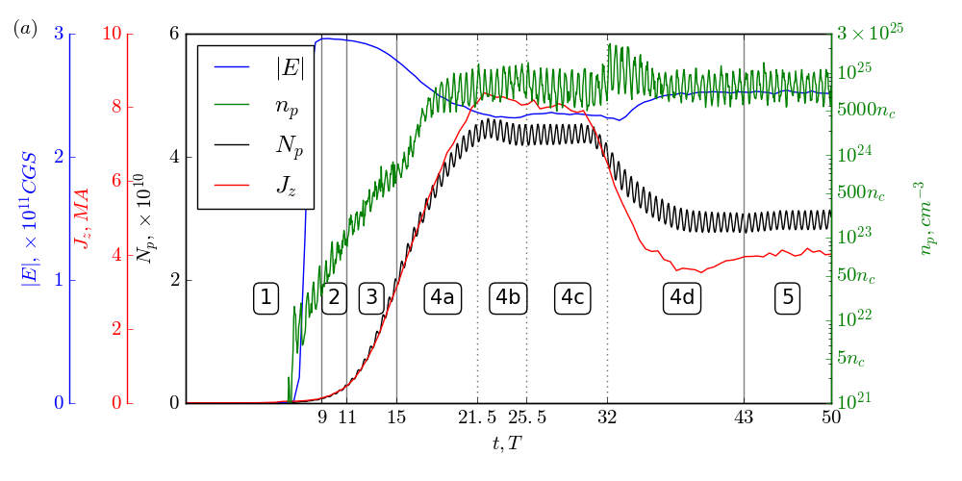
Overdense electron-positron plasma states
5 stage – steady state (for > 50-100T)
Density distribution is two-sheets distribution
Always reached

Slide 35
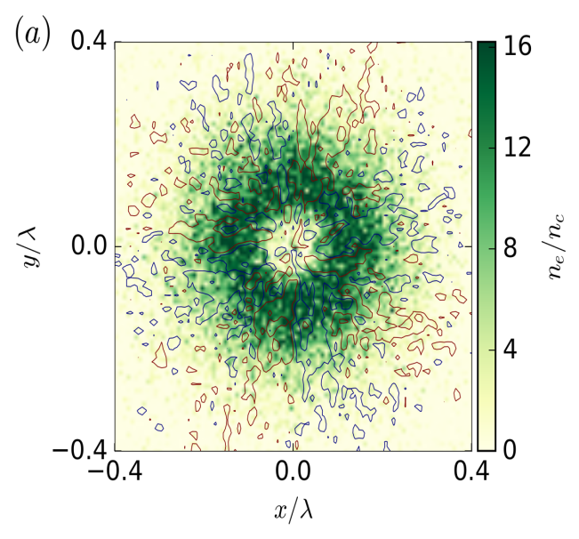
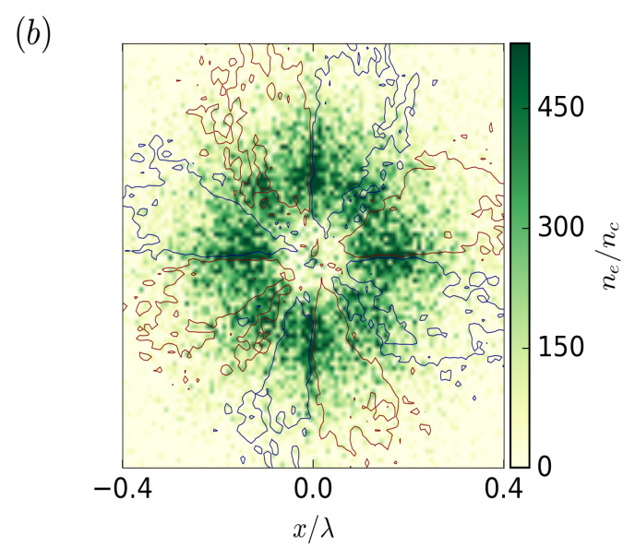
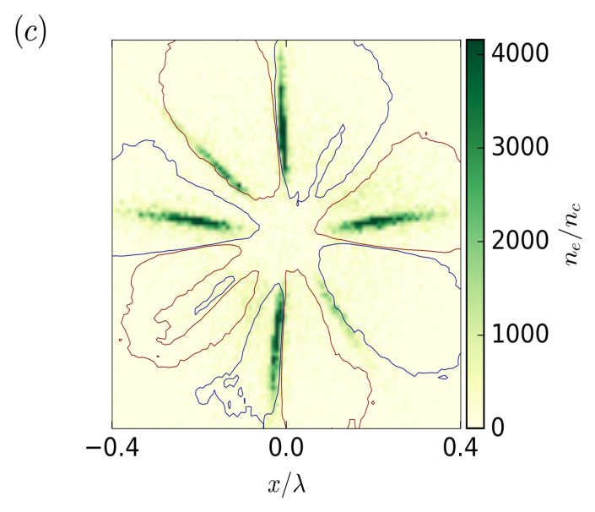
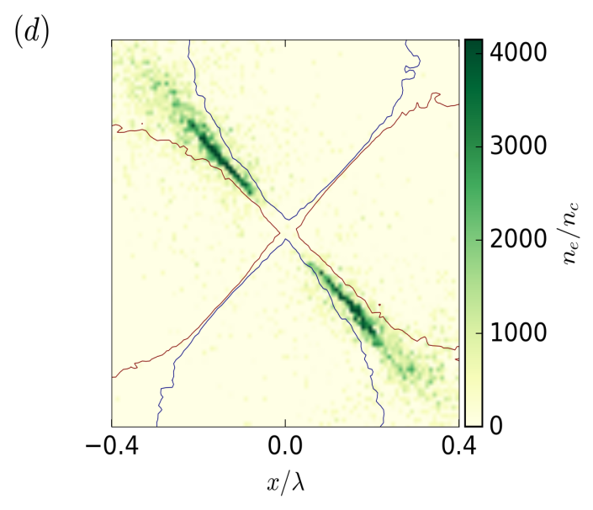
Overdense electron-positron plasma states

Slide 36
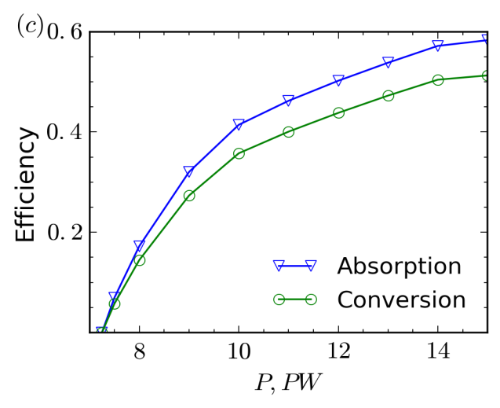
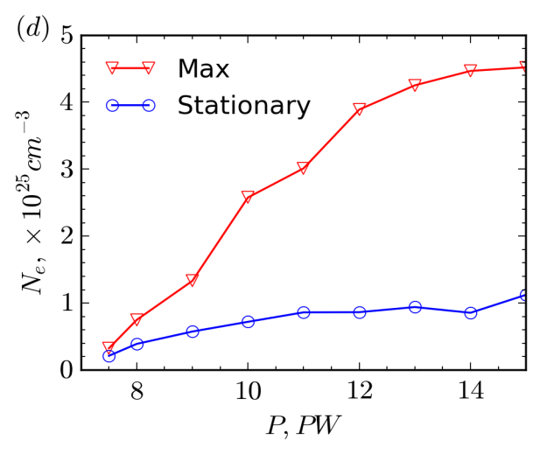

Overdense electron-positron plasma states
Efficiency up to 60%
Current ~ 3-5 MA (steady state), 10-15 MA(nonlinear stage)
Pair plasma density ~ 10²⁵ cm⁻³
E.S.Efimenko et al., Scientific Reports, 2018

Slide 37

XCELS 10²⁶ W/cm²-and-Beyond Program
Overcritical plasma surface
Incident pulse 10¹⁸ -10²³ W/cm²
Re-emitted pulse
Oscillating Mirror Model (OMM)
S.V. Bulanov et al., Phys. Plasmas (1994)
S.R. Lichters et al., Phys. Plasmas (1996)
S. Gordienko et al, PRL (2004)
N. M. Naumova et al, PRL (2004)
T. Baeva et al., PRE (2006)
D. an der Brugge at al, Phys. Plasmas (2010)
Incident pulse >10²³ W/cm²
Relativistic Electronic Spring (RES) Model
A.Gonoskov et al, PRE (2011)
J.Fuchs et al, EJP (2014)

Slide 38
Effect of Relativistic Electronic Spring
Stages:
1) pushing of electrons and the formation of a thin current layer- nanoplasmonic structure, which results in energy transfer from the laser field to the plasma fields and particles;
2) backward motion of the electrons towards the incident wave with conversion of energy accumulated in the plasma and laser field energy into the kinetic energy of an ultrarelativistic electron bunch;
3) radiation of the attosecond pulse by an electron bunch due to conversion of the kinetic energy and laser field energy to the XUV and X- ray range.
Y
X
electrons
Z
ions

Slide 39



Optimal Conditions and Efficiency of
Giant Attosecond Pulse Generation
A.Gonoskov et al, Phys. Rev. E (2011)
J. Fuchs et al, EJP (2014)
Classifcation of Interaction Type:
OMM- oscillating mirror
RES - relativistic electronic spring
RIST - relativistically induced
solid target transparency
RIST
RIST
RES
RES
N_{e}, cm⁻³
N_{e}, cm⁻³
S=5
δ
S=5
OMM
OMM
I, W/cm²
I, W/cm²
δ = W_{acc} / W_{cycle} – coefficient of energy transformation
a_{g}/a_{in} – amplitude enhancement
M. Behmke et al, PRL (2011)
experiment

Slide 40

Groove Shape Target and Superluminal Focal Spot

Slide 41


Pair Production from Vacuum with
Attosecond Superluminal Probe
For 200 PW and 10²³W/cm² at the groove target 0.5 mm wide
we have 10²⁸ W/cm² in the volume V~10nm³
Number of pairs N~10⁹
Cascades are strongly suppressed due superluminal motion of the focal area
10²⁸ W/cm²
10 nm
v_{f} = c/sinθ
0.5 mm

Slide 42
In Conclusion
We are at the entrance to a new realm of physical phenomena
Exawatt-scale lasers will bring particle dynamics in the radiation dominated regime
QED cascades and radiation trapping of particles produce ultrarelativistic, ultradense e-e+ plasma that efficiently convert optical energy to gamma rays
Controllable directed gamma ray sources of GeV photons with extreme brilliance will be soon available as a new instrument to study nuclear matter and vacuum physics
Laboratory astrophysics will be provided with Gigagauss and Teragauss magnetc fields on the Earth
By energy conversion from femtosecond to attosecond pulses, the Schwinger field can be approached and time-space structure of vacuum can be studied

